Slide 1
Unit-5 Files

Slide 2
Introduction
A file is a named collection of related information that is recorded on secondary storage.
files may be numeric, alphabetic, alphanumeric, or binary
A text file is a sequence of characters organized into lines (and possibly pages)
A source file is a sequence of functions, each of which is further organized as declarations followed by executable statements
An executable file is a series of code sections that the loader can bring into memory and execute.

Slide 3
File Attributes
A file is named, for the convenience of its human users, and is referred to by its name.
A name is usually a string of characters, such as example.c.
A file’s attributes vary from one operating system to another but typically consist of these:
Name. The symbolic file name is the only information kept in human readable form.
Identifier. This unique tag, usually a number, identifies the file within the file system; it is the non-human-readable name for the file.
Type. This information is needed for systems that support different types of files.
Location. This information is a pointer to a device and to the location of the file on that device.
Size. The current size of the file (in bytes, words, or blocks)
Protection. Access-control information determines who can do reading, writing, executing, and so on
Time, date, and user identification. This information may be kept for creation, last modification, and last use. These data can be useful for protection, security, and usage monitoring

Slide 4
File Operations
A file is an abstract data type. To define a file properly, we need to consider the operations that can be performed on files.
The operating system can provide system calls to create, write, read, reposition, delete, and truncate files.
Let’s examine what the operating system must do to perform each of these six basic file operations.
Creating a file. Two steps are necessary to create a file. First, space in the file system must be found for the file. Second, an entry for the new file must be made in the directory.
Writing a file. To write a file, we make a system call specifying both the name of the file and the information to be written to the file. Given the name of the file, the system searches the directory to find the file’s location. The system must keep a write pointer to the location in the file where the next write is to take place. The write pointer must be updated whenever a write occurs.
Reading a file. To read from a file, we use a system call that specifies the name of the file. system needs to keep a read pointer to the location in the file where the next read is to take place. Once the read has taken place, the read pointer is updated. Because a process is usually either reading from or writing to a file, the current operation location can be kept as a per-process current-file-position pointer. Both the read and write operations use this same pointer, saving space.
Repositioning within a file. The directory is searched for the appropriate entry, and the current-file-position pointer is repositioned to a given value. Repositioning within a file need not involve any actual I/O. This file operation is also known as a file seek.
Deleting a file. To delete a file, we search the directory for the named file. Having found the associated directory entry, we release all file space, so that it can be reused by other files, and erase the directory entry.
Truncating a file. The user may want to erase the contents of a file but keep its attributes. Rather than forcing the user to delete the file and then recreate it, this function allows all attributes to remain unchanged—except for file length

Slide 5
The operating system keeps a table, called the open-file table, containing information about all open files.
Some systems implicitly open a file when the first reference to it is made. The file is automatically closed when the job or program that opened the file terminates.
The implementation of the open() and close() operations is more complicated in an environment where several processes may open the file simultaneously.
Typically, the operating system uses two levels of internal tables: a per-process table and a system-wide table.
The per-process table tracks all files that a process has open. Stored in this table is information regarding the process’s use of the file. For instance, the current file pointer for each file is found here. Access rights to the file and accounting information can also be included.
Each entry in the per-process table in turn points to a system-wide open-file table. The system-wide table contains process-independent information, such as the location of the file on disk, access dates, and file size.
Once a file has been opened by one process, the system-wide table includes an entry for the file.
When another process executes an open() call, a new entry is simply added to the process’s open-file table
Typically, the open-file table also has an open count associated with each file to indicate how many processes have the file open. Each close() decreases this open count, and when the open count reaches zero, the file is no longer in use, and the file’s entry is removed from the open-file table.

Slide 6
several pieces of information are associated with an open file.
File pointer-
File-open count-
Disk location of the file-
Access rights-

Slide 7
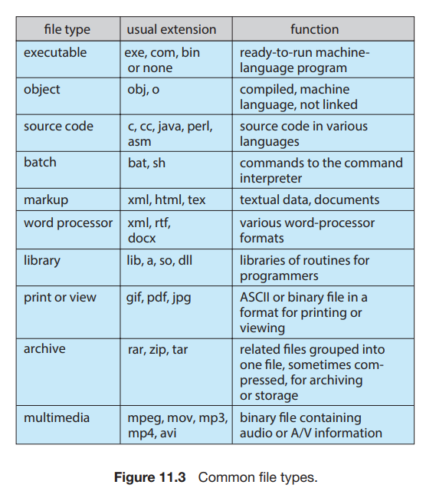
File Types
A common technique for implementing file types is to include the type as part of the file name. The name is split into two parts—a name and an extension

Slide 8
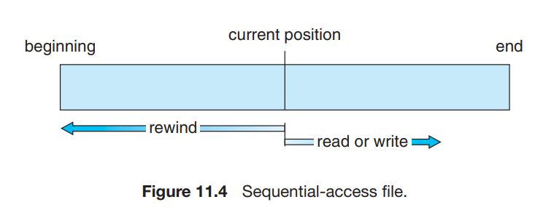
Access Methods
Sequential Access
Information in the file is processed in order, one record after the other. This mode of access is by far the most common; for example, editors and compilers usually access files in this fashion.
operation—read next()—reads the next portion of the file and automatically advances a file pointer
operation—write next()—appends to the end of the file and advances to the end of the newly written material
Such a file can be reset to the beginning

Slide 9
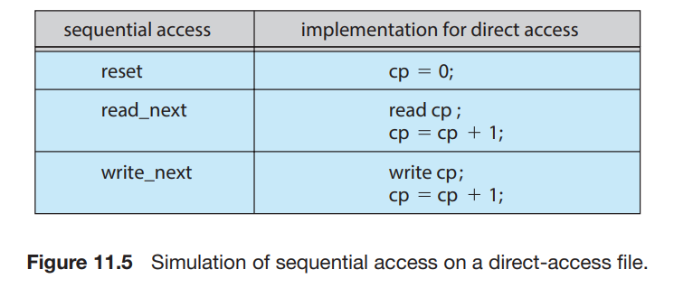
Direct Access
Also called relative access
The file is viewed as a numbered sequence of blocks or records. Thus, we may read block 14, then read block 53, and then write block 7. There are no restrictions on the order of reading or writing for a direct-access file.
For the direct-access method, the file operations must be modified to include the block number as a parameter.
Thus, we have read(n), where n is the block number, rather than read next()
and write(n) rather than write next().
An alternative approach is to retain read next() and write next(), as with sequential access, and to add an operation position file(n) where n is the block number.
position file(n) and then read next().

Slide 10
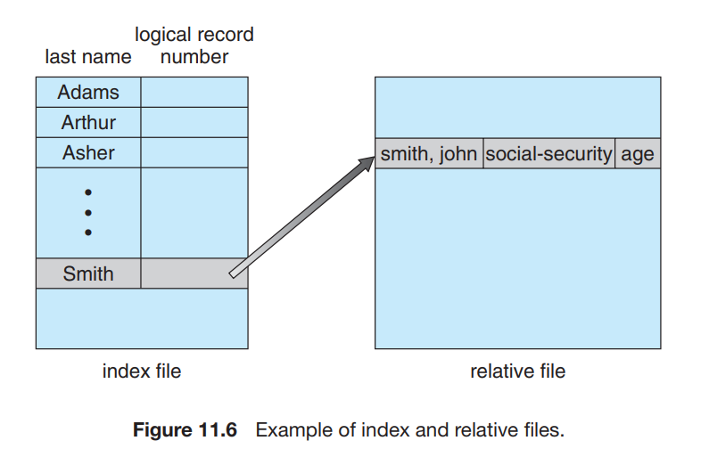
Other Access Methods
Bulit on top of a direct-access method.
an index contains pointers to the various blocks
we first search the index and then use the pointer to access the file directly and to find the desired record.

Slide 11
Directory and Disk Structure
Files are stored on random-access storage devices, including hard disks, optical disks, and solid-state (memory-based) disks.
A storage device can be used in its entirety for a file system.
It can also be subdivided for finer-grained control.
For example, a disk can be partitioned into quarters, and each quarter can hold a separate file system.
Storage devices can also be collected together into RAID sets that provide protection from the failure of a single disk

Slide 12
Partitioning helps in putting multiple file-system types on the same device
A file system can be created on each of these parts of the disk. Any entity containing a file system is generally known as a volume.
Volumes can also store multiple operating systems, allowing a system to boot and run more than one operating system.
Each volume that contains a file system must also contain information about the files in the system.
This information is kept in entries in a device directory or volume table of contents.
The device directory (more commonly known simply as the directory) records information—such as name, location, size, and type—for all files on that volume.

Slide 13
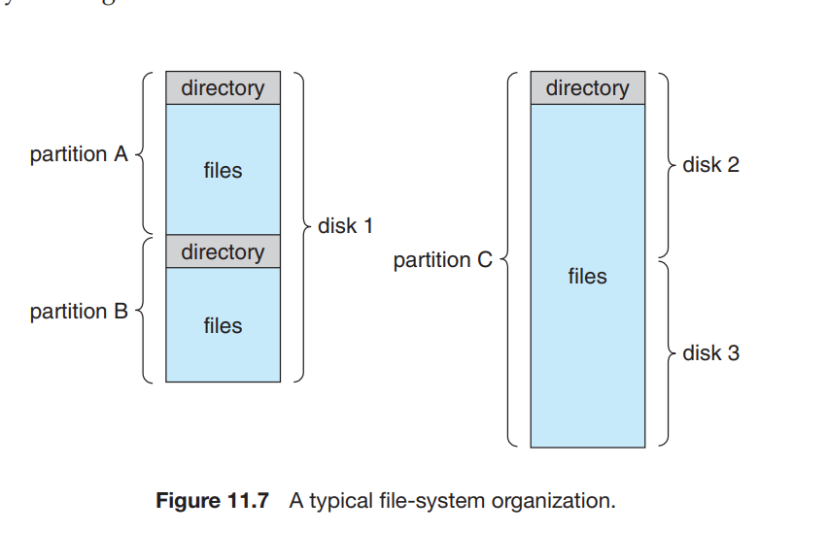

Slide 14
Directory Overview
The directory can be viewed as a symbol table that translates file names into their directory entries.
considering a particular directory structure, we need to keep in mind the operations that are to be performed on a directory:
Search for a file-We need to be able to search a directory structure to find the entry for a particular file.
Create a file. New files need to be created and added to the directory.
Delete a file. When a file is no longer needed, we want to be able to remove it from the directory.
List a directory. We need to be able to list the files in a directory and the contents of the directory entry for each file in the list.
Rename a file. Because the name of a file represents its contents to its users, we must be able to change the name when the contents or use of the file changes.
Traverse the file system. We may wish to access every directory and every file within a directory structure

Slide 15
Single-Level Directory –
The simplest directory structure is the single-level directory.
All files are contained in the same directory, which is easy to support and understand.
A single-level directory has significant limitations, however, when the number of files increases or when the system has more than one user. Since all files are in the same directory, they must have unique names.
Fortunately, most file systems support file names of up to 255 characters, so it is relatively easy to select unique file names.
Two-Level Directory-
Each user has his own user file directory (UFD). The UFDs have similar structures, but each lists only the files of a single user.
When a user job starts or a user logs in, the system’s master file directory (MFD) is searched. The MFD is indexed by user name or account number, and each entry points to the UFD for that user

Slide 16
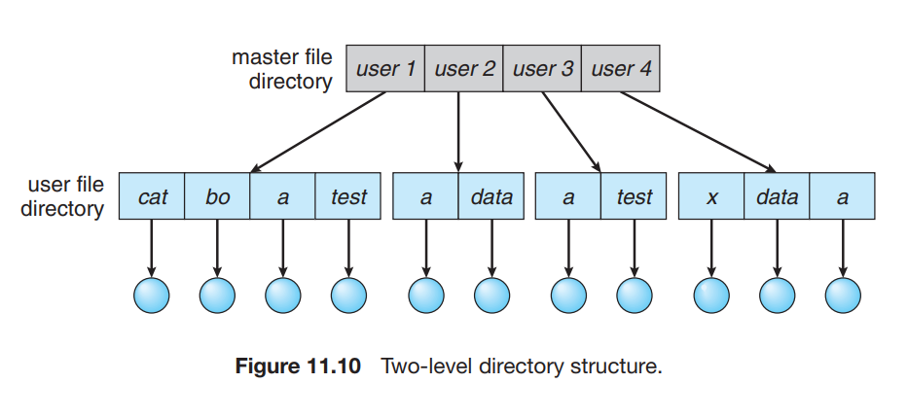
For example, if user A wishes to access her own test file named test.txt, she can simply refer to test.txt. To access the file named test.txt of user B (with directory-entry name userb), however, she might have to refer to /userb/test.txt. Every system has its own syntax for naming files in directories other than the user’s own.

Slide 17
Tree-Structured Directories-
Once we have seen how to view a two-level directory as a two-level tree, the natural generalization is to extend the directory structure to a tree of arbitrary height. A tree is the most common directory structure.
The tree has a root directory, and every file in the system has a unique path name.
A directory (or subdirectory) contains a set of files or subdirectories.
One bit in each directory entry defines the entry as a file (0) or as a subdirectory (1).
Each process has a current directory. The current directory should contain most of the files that are of current interest to the process. When reference is made to a file, the current directory is searched. If a file is needed that is not in the current directory, then the user usually must either specify a path name or change the current directory to be the directory holding that file.
From one change directory() system call to the next, all open() system calls search the current directory for the specified file.
Path names can be of two types: absolute and relative.
An absolute path name begins at the root and follows a path down to the specified file, giving the directory names on the path.
A relative path name defines a path from the current directory.

Slide 18
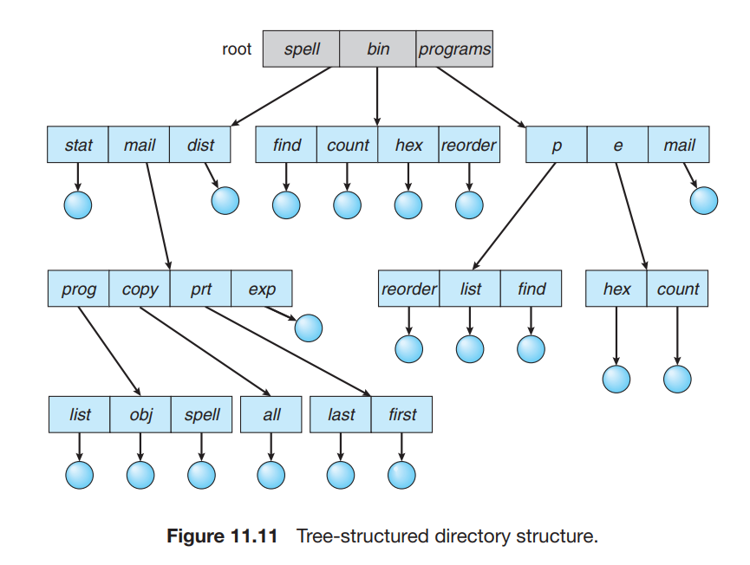
For example, in the tree-structured file system of Figure 11.11, if the current directory is root/spell/mail, then the relative path name prt/first refers to the same file as does the absolute path name root/spell/mail/prt/first.

Slide 19
Acyclic-Graph Directories
Consider two programmers who are working on a joint project. The files associated with that project can be stored in a subdirectory, separating them from other projects and files of the two programmers.
But since both programmers are equally responsible for the project, both want the subdirectory to be in their own directories. In this situation, the common subdirectory should be shared.
A shared directory or file exists in the file system in two (or more) places at once.
A tree structure prohibits the sharing of files or directories.
An acyclic graph —that is, a graph with no cycles—allows directories to share subdirectories and files

Slide 20
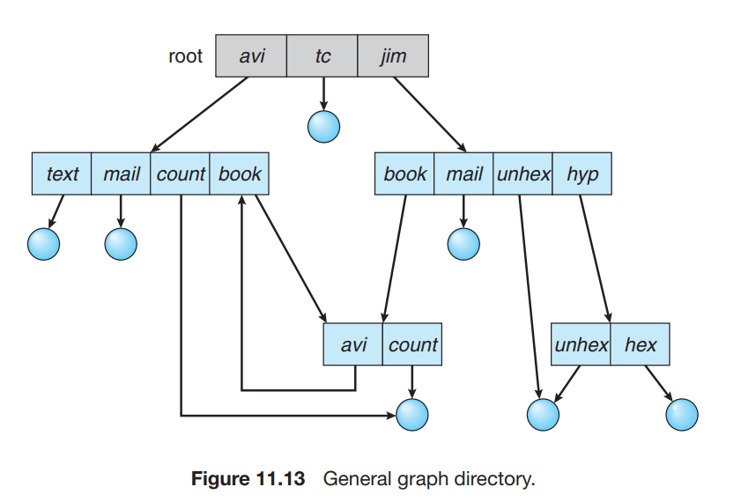
General Graph Directory-
A serious problem with using an acyclic-graph structure is ensuring that there are no cycles. If we start with a two-level directory and allow users to create subdirectories, a tree-structured directory results.
It should be fairly easy to see that simply adding new files and subdirectories to an existing tree-structured directory preserves the tree-structured nature.
However, when we add links, the tree structure is destroyed, resulting in a simple graph structure

Slide 21
The primary advantage of an acyclic graph is the relative simplicity of the algorithms to traverse the graph and to determine when there are no more references to a file.
We want to avoid traversing shared sections of an acyclic graph twice, mainly for performance reasons. If we have just searched a major shared subdirectory for a particular file without finding it, we want to avoid searching that subdirectory again; the second search would be a waste of time.
If cycles are allowed to exist in the directory, we likewise want to avoid searching any component twice, for reasons of correctness as well as performance.
Garbage collection involves traversing the entire file system, marking everything that can be accessed. Then, a second pass collects everything that is not marked onto a list of free space.

Slide 22
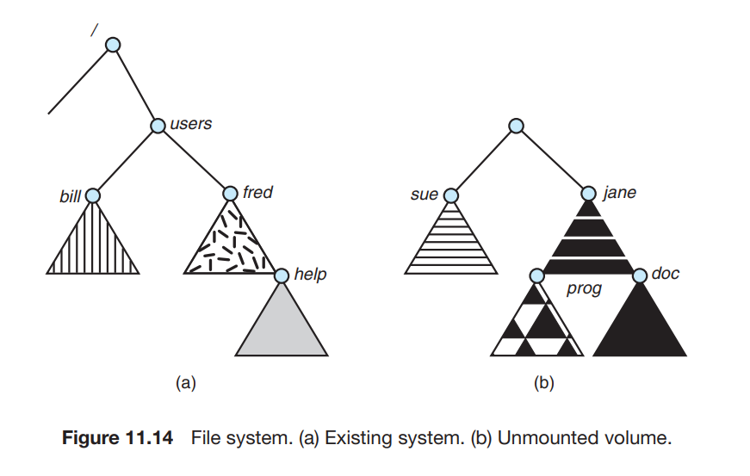
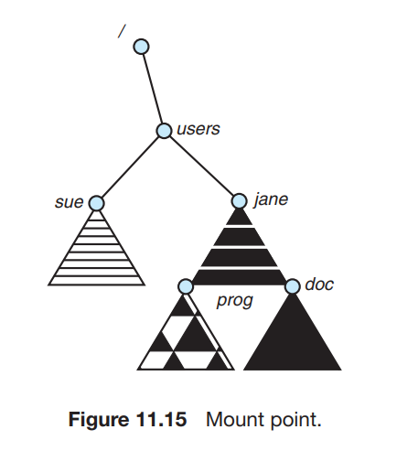
File-System Mounting
Just as a file must be opened before it is used
a file system must be mounted before it can be available to processes on the system.
The operating system is given the name of the device and the mount point—the location within the file structure where the file system is to be attached.

Slide 23
File Sharing
Multiple Users
The owner is the user who can change attributes and grant access and who has the most control over the file.
The group attribute defines a subset of users who can share access to the file.
For example, the owner of a file on a UNIX system can issue all operations on a file, while members of the file’s group can execute one subset of those operations, and all other users can execute another subset of operations.
The owner and group IDs of a given file (or directory) are stored with the other file attributes. When a user requests an operation on a file, the user ID can be compared with the owner attribute to determine if the requesting user is the owner of the file. Likewise, the group IDs can be compared.

Slide 24
Remote File Systems
With the advent of networks, communication among remote computers became possible. Networking allows the sharing of resources spread across a campus or even around the world
The first implemented method involves manually transferring files between machines via programs like ftp.
The second major method uses a distributed file system (DFS) in which remote directories are visible from a local machine.
In some ways, the third method, the World Wide Web, is a reversion to the first. A browser is needed to gain access to the remote files, and separate operations (essentially a wrapper for ftp) are used to transfer files.

Slide 25
The Client–Server Mode
In this case, the machine containing the files is the server, and the machine seeking access to the files is the client. The client–server relationship is common with networked machines.
A server can serve multiple clients, and a client can use multiple servers, depending on the implementation details of a given client–server facility.

Slide 26
Distributed Information Systems
To make client–server systems easier to manage, distributed information systems, also known as distributed naming services, provide unified access to the information needed for remote computing
The domain name system (DNS) provides host-name-to-network-address translations for the entire Internet. Before DNS became widespread, files containing the same information were sent via e-mail or ftp between all networked hosts

Slide 27
Consistency semantics
represent an important criterion for evaluating any file system that supports file sharing.
These semantics specify how multiple users of a system are to access a shared file simultaneously.
They specify when modifications of data by one user will be observable by other users.
Consistency semantics are directly related to the process synchronization
UNIX Semantics-uses the following consistency semantics:
Writes to an open file by a user are visible immediately to other users who have this file open.
One mode of sharing allows users to share the pointer of current location into the file
Session Semantics
Andrew file system (OpenAFS) uses the following semantics:
Writes to an open file by a user are not visible immediately to other users that have the same file open.
Once a file is closed, the changes made to it are visible only in sessions starting later. Already open instances of the file do not reflect these changes.
Immutable-Shared-Files Semantics
A unique approach is that of immutable shared files. Once a file is declared as shared by its creator, it cannot be modified.
An immutable file has two key properties: its name may not be reused, and its contents may not be altered.

Slide 28
File-System Structure
Disks provide most of the secondary storage on which file systems are maintained. Two characteristics make them convenient for this purpose:
1. A disk can be rewritten in place; it is possible to read a block from the disk, modify the block, and write it back into the same place.
2. A disk can access directly any block of information it contains. Thus, it is simple to access any file either sequentially or randomly
File systems provide efficient and convenient access to the disk by allowing data to be stored, located, and retrieved easily.
The file system itself is generally composed of many different levels.

Slide 29
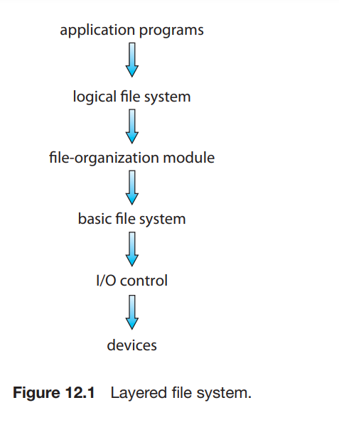
The I/O control level consists of device drivers and interrupt handlers to transfer information between the main memory and the disk system.
The basic file system needs only to issue generic commands to the appropriate device driver to read and write physical blocks on the disk.
The file-organization module knows about files and their logical blocks, as well as physical blocks.
The logical file system manages metadata information

Slide 30
File-System Implementation
A boot control block (per volume) can contain information needed by the system to boot an operating system from that volume. In UFS, it is called the boot block. In NTFS, it is the partition boot sector.
A volume control block (per volume) contains volume (or partition) details, such as the number of blocks in the partition, the size of the blocks. In UFS, this is called a superblock. In NTFS, it is stored in the master file table.
A directory structure (per file system) is used to organize the files
An in-memory mount table contains information about each mounted volume.
An in-memory directory-structure cache holds the directory information of recently accessed directories.
The system-wide open-file table contains a copy of the FCB of each open file, as well as other information.

Slide 31
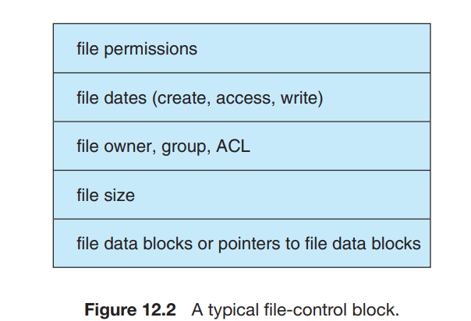
All file operations are then performed via this pointer.
UNIX systems refer to it as a file descriptor; Windows refers to it as a file handle.

Slide 32
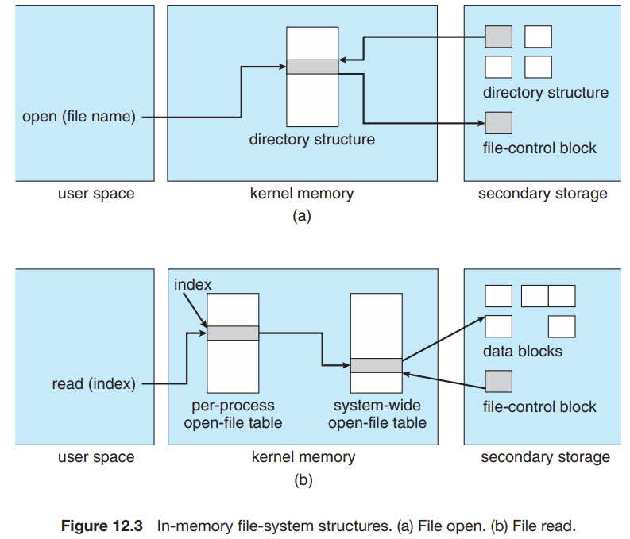

Slide 33
Partitions and Mounting-
The layout of a disk can have many variations, depending on the operating system. A disk can be sliced into multiple partitions.
Modern operating systems must concurrently support multiple types of file systems
Virtual File Systems(VFS)-
Data structures and procedures are used to isolate the basic system call functionality from the implementation details
The first layer is the file-system interface, based on the open(), read(), write(), and close() calls and on file descriptors
The second layer is called the virtual file system (VFS) layer. The VFS layer serves two important functions:
It separates file-system-generic operations from their implementation by defining a clean VFS interface.
It provides a mechanism for uniquely representing a file throughout a network. The VFS is based on a file-representation structure, called a vnode
Thus, the VFS distinguishes local files from remote ones, and local files are further distinguished according to their file-system types.
The VFS activates file-system-specific operations to handle local requests according to their file-system types and calls the NFS protocol procedures for remote requests.

Slide 34
The four main object types defined by the Linux VFS are:
The inode object, which represents an individual file
The file object, which represents an open file
The superblock object, which represents an entire file system
The dentry object, which represents an individual directory entry
an abbreviated API for some of the operations for the file object includes:
int open(. . .)—Open a file.
int close(...)—Close an already-open file.
ssize t read(. . .)—Read from a file.
ssize t write(. . .)—Write to a file.
int mmap(. . .)—Memory-map a file.

Slide 35
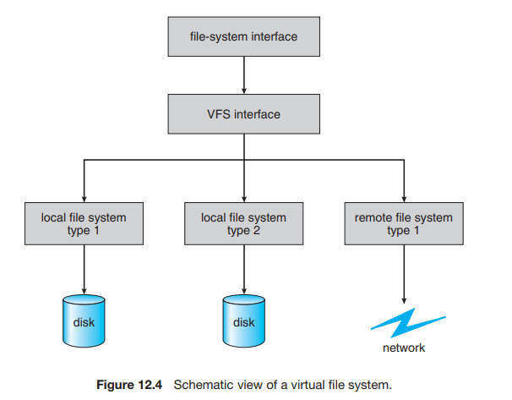

Slide 36
Directory Implementation
Linear List
The simplest method of implementing a directory
This method is simple to program but time-consuming to execute.
To create a new file, we must first search the directory to be sure that no existing file has the same name. Then, we add a new entry at the end of the directory.
To delete a file, we search the directory for the named file and then release the space allocated to it.
To reuse the directory entry, we can do one of several things.
we can mark the entry as unused
we can attach it to a list of free directory entries
To copy the entry into the freed location and to decrease the length of the directory
The real disadvantage of a linear list of directory entries is that finding a file requires a linear search

Slide 37
Hash Table
Here, a linear list stores the directory entries, but a hash data structure is also used.
The hash table takes a value computed from the file name and returns a pointer to the file name in the linear list. Therefore, it can greatly decrease the directory search time
Insertion and deletion are also fairly straightforward, although some provision must be made for collisions—situations in which two file names hash to the same location
The major difficulties with a hash table are its generally fixed size and the dependence of the hash function on that size

Slide 38
Allocation Methods
Three major methods of allocating disk space are in wide use: contiguous, linked, and indexed.
Contiguous allocation:
requires that each file occupy a set of contiguous blocks on the disk.
accessing block b + 1 after block b normally requires no head movement.
When head movement is needed (from the last sector of one cylinder to the first sector of the next cylinder), the head need only move from one track to the next
If the file is n blocks long and starts at location b, then it can hop blocks b, b + 1, b + 2, ..., b + n − 1.
For direct access to block i of a file that starts at block b, we can immediately access block b + i. Thus, both sequential and direct access can be supported by contiguous allocation.

Slide 39
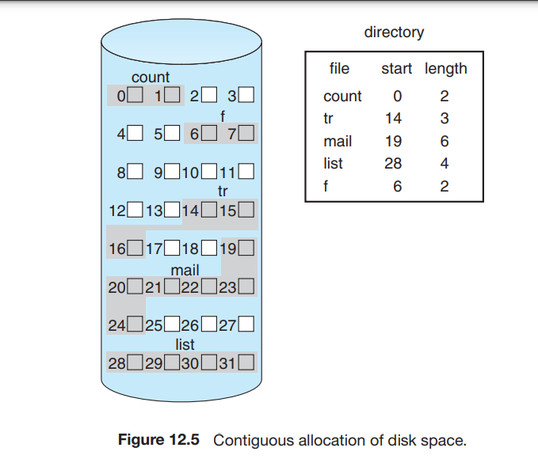
All these algorithms suffer from the problem of external fragmentation.
As files are allocated and deleted, the free disk space is broken into little pieces.
External fragmentation exists whenever free space is broken into chunks. It

Slide 40
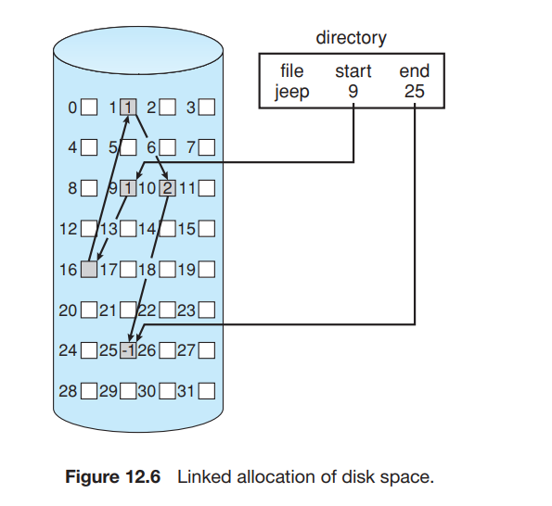
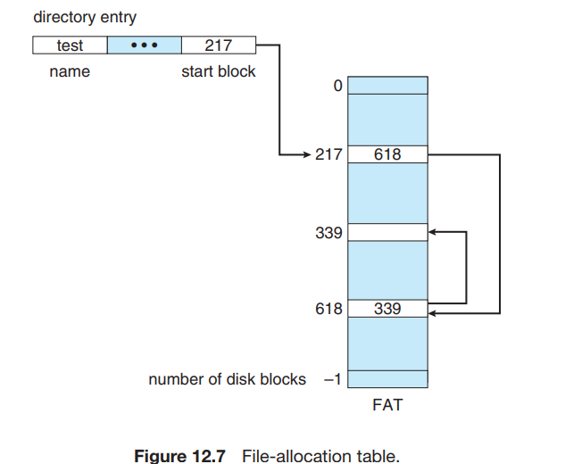
Linked Allocation:
Linked allocation solves all problems of contiguous allocation.
With linked allocation, each file is a linked list of disk blocks; the disk blocks may be scattered anywhere on the disk.
The directory contains a pointer to the first and last blocks of the file.

Slide 41
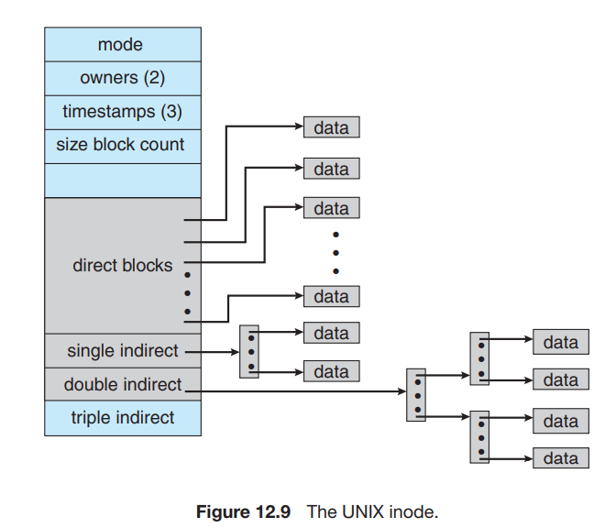
Indexed Allocation:
Linked allocation solves the external-fragmentation and size-declaration problems of contiguous allocation.
However, in the absence of a FAT, linked allocation cannot support efficient direct access, since the pointers to the blocks are scattered with the blocks themselves all over the disk and must be retrieved in order.
Indexed allocation solves this problem by bringing all the pointers together into one location: the index block.
The directory contains the address of the index block.
To find and read the ith block, we use the pointer in the ith index-block entry. This scheme is similar to the paging scheme

Slide 42
Free-Space Management
Since disk space is limited, we need to reuse the space from deleted files for new files, if possible.
SOMETIMES Write-once optical disks allow only one write to any given sector, and thus reuse is not physically possible.
To keep track of free disk space, the system maintains a free-space list.
The free-space list records all free disk blocks—those not allocated to some file or directory.
Bit Vector
Frequently, the free-space list is implemented as a bit map or bit vector.
Each block is represented by 1 bit. If the block is free, the bit is 1; if the block is allocated, the bit is 0.
For example, consider a disk where blocks 2, 3, 4, 5, 8, 9, 10, 11, 12, 13, 17, 18, 25, 26, and 27 are free and the rest of the blocks are allocated.
The free-space bit map would be 001111001111110001100000011100000 ....
Adv:
Relative simplicity and its efficiency in finding the first free block

Slide 43
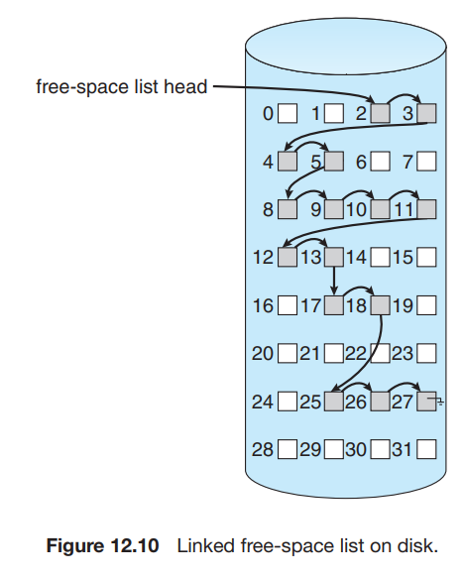
Linked List
Another approach to free-space management is to link together all the free disk blocks.
This first block contains a pointer to the next free disk block, and so on.
ex blocks 2, 3, 4, 5, 8, 9, 10, 11, 12, 13, 17, 18, 25, 26, and 27 were free and the rest of the blocks were allocated.
keep a pointer to block 2 as the first free block. Block 2 would contain a pointer to block 3, which would point to block 4, which would point to block 5, which would point to block 8, and so on.
This scheme is not efficient; to traverse the list, we must read each block, which requires substantial I/O time.
Grouping:
A modification of the free-list approach stores the addresses of n free blocks in the first free block.

